Slide 1
Dissolvable Data
Andy Oh Sean Slavin Baskaran Viswanathan

Slide 2
Where to set up a company?

Slide 3
Quick Facts
USELESS
3 Brains
11 Days
28 hours of brainpower
3 MacBooks
0 Energy Drink
# of Hours Worked on Project
Date | Day | Baskaran | Sean | Andy
9/19 | Tuesday | 3 | 3 | 3
9/20 | Wednesday | 1 | 0 | 1
9/21 | Thursday | 3 | 4 | 3
9/22 | Friday | 0 | 0 | 1
9/23 | Saturday | 4 | 5 | 4
9/24 | Sunday | 2 | 0 | 0
9/25 | Monday | 0 | 2 | 1
9/26 | Tuesday | 4 | 3 | 3
9/27 | Wednesday | 1 | 2 | 1
9/28 | Thursday | 4 | 3 | 3
9/29 | Friday | 4 | 6 | 6
11 Days |  | 26 | 28 | 26

Slide 5
Collaboration Tools

Slide 6
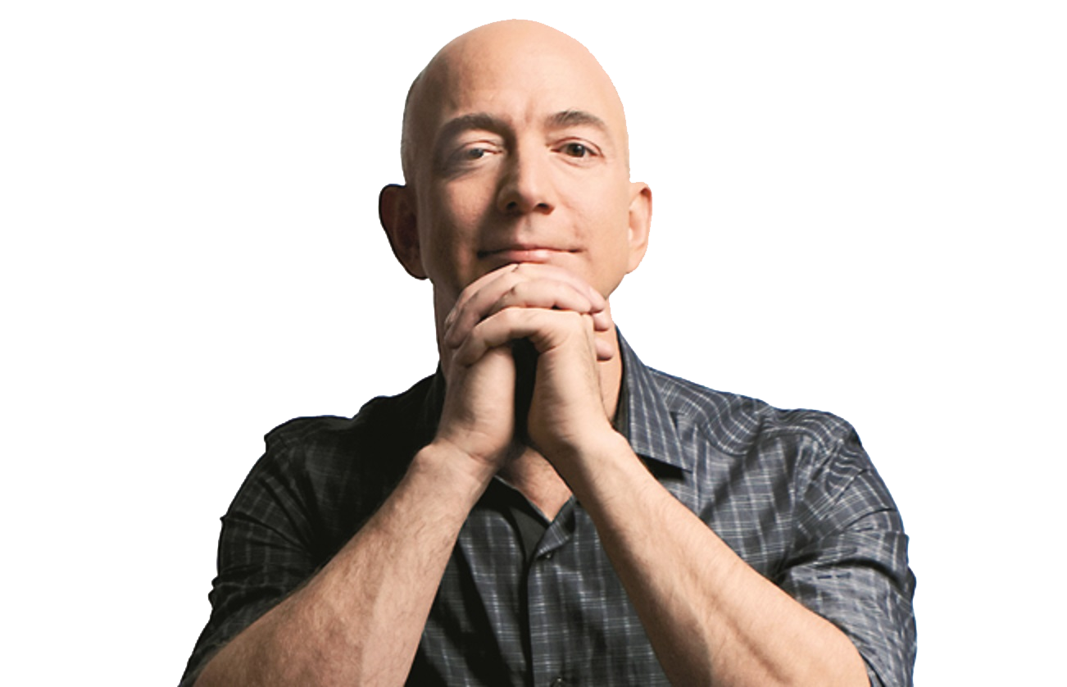
Jeff Bezos
Amazon HQ2
Population ≥ 1,000,000
Major Airport ≤ 45 minutes
City Center ≤ 30 miles
50,000 workers

Slide 7
Data Source
U.S. Census Bureau
https://www.census.gov/data.html
U.S. Bureau of Labor Statistics
https://www.bls.gov/data/#api
OurAirports
http://ourairports.com/data/
Google Map API – Distance Matrix
https://developers.google.com/maps/documentation/distance-matrix/

Slide 8
Process
Census Data
Labor Force Data
Airport Data
Distance Matrix

Slide 9
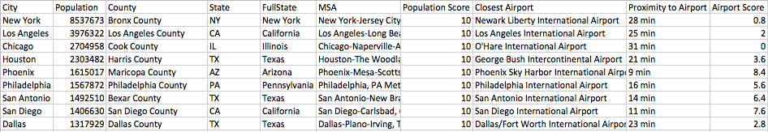
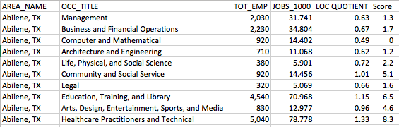
Raw Data
Census Data
Labor Force Data

Slide 10
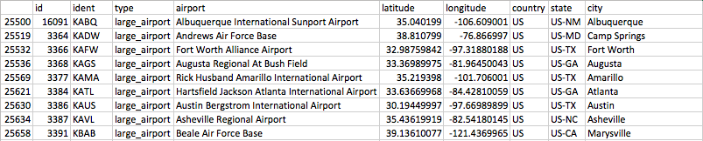
Airport Data

Slide 13
Code

Slide 14
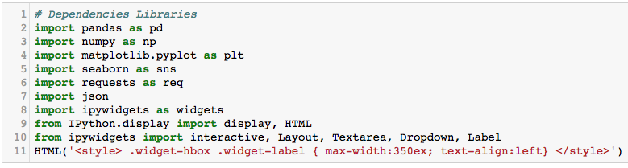

Slide 15
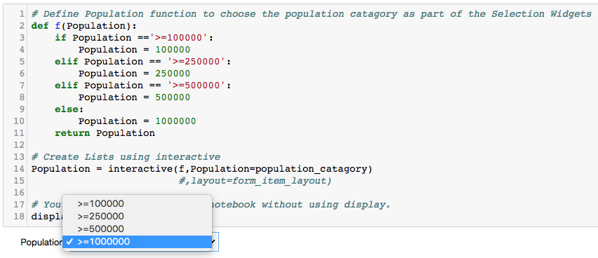

Slide 16
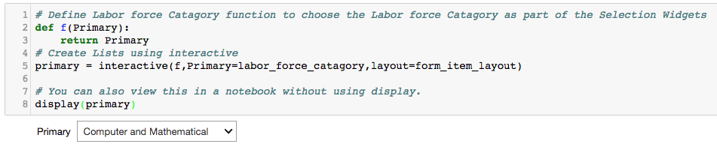

Slide 17
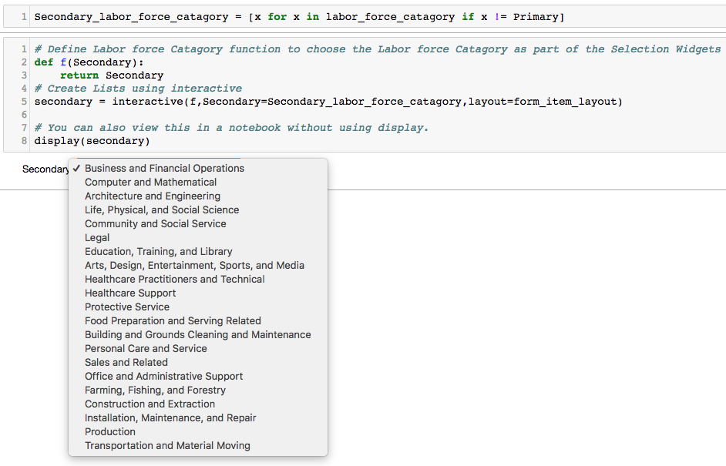

Slide 18
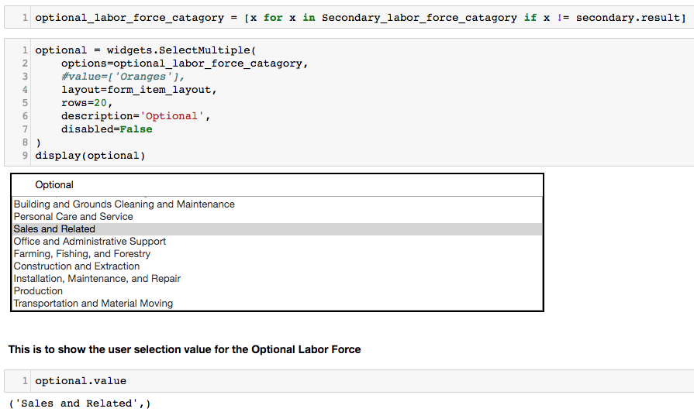

Slide 19
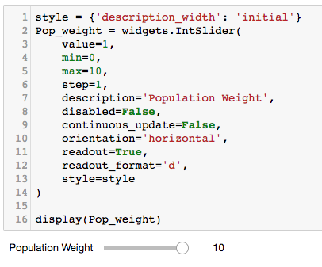
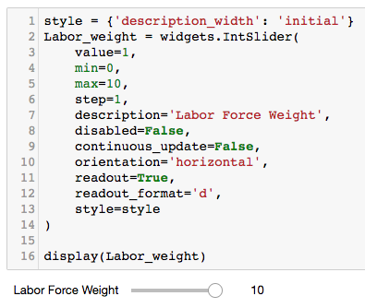

Slide 20
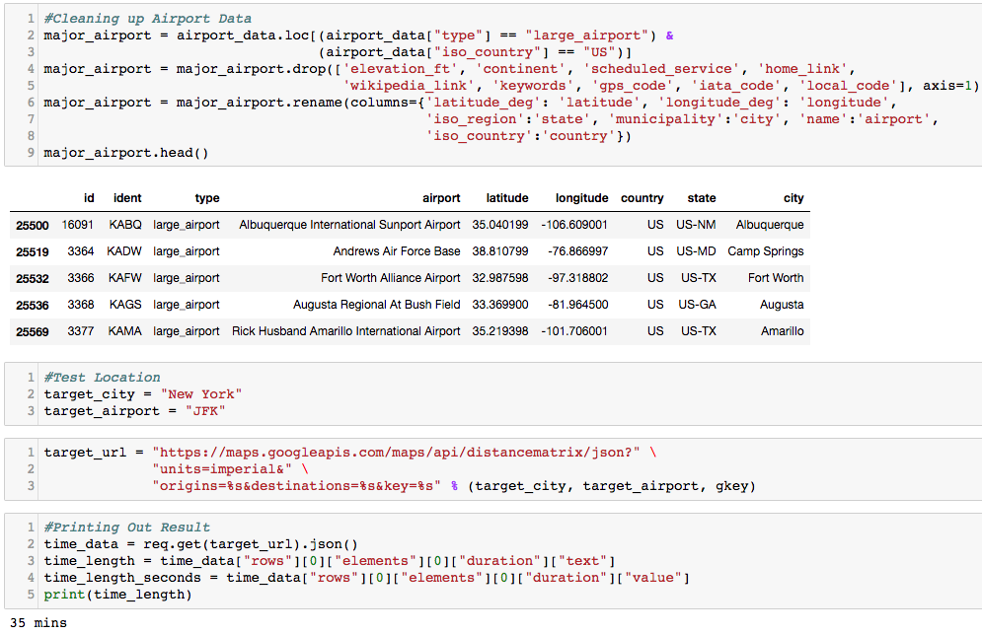

Slide 21
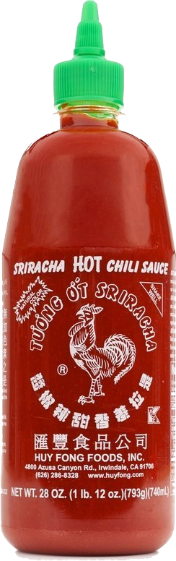
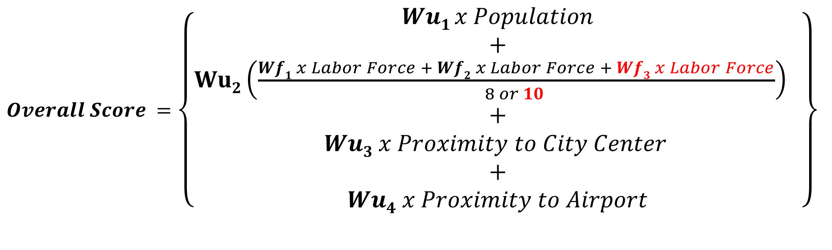
The Secret Sauce
$Overall Score =$ $\left\{\begin{aligned}Wu1 x Population \\ + \\ Wu2\left(\frac{Wf1 x Labor Force + Wf2 x Labor Force + Wf3 x Labor Force}{8 or 10 }\right) \\ + \\ Wu3 x Proximity to City Center \\ + \\ Wu4 x Proximity to Airport\end{aligned}\right\}$
Wu_{1…4} and Wf_{1…3} are weighted values

Slide 22
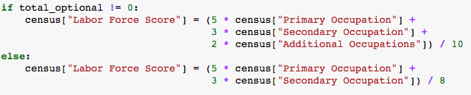
Secret Sauce in Code

Slide 23
Result – Amazon HQ2

Slide 24
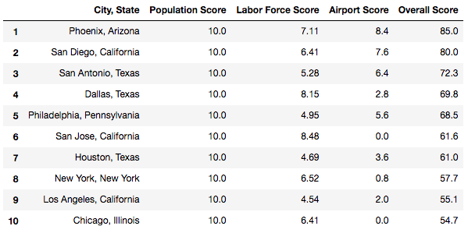

Slide 25
textio
MarketWatch

Slide 26
Quartz
Brookings Institution

Slide 27

Result Comparisons
Dissolvable Data
# | City
1 | Phoenix
2 | San Diego
3 | San Antonio
4 | Dallas
5 | Philadelphia
Bloomberg
# | City
1 | Toronto
2 | Boston
3 | Washington
4 | Atlanta
5 | Dallas
Quartz
# | City
1 | Salt Lake City
2 | Denver
3 | Boston
4 | Raleigh
5 | Washington DC
MarketWatch
# | City
 | Atlanta
 | Austin
 | Baltimore
 | Boston
 | Bridgeport
CityLab
# | City
1 | Chicago
2 | Dallas
3 | Philadelphia
4 | Atlanta
5 | Phoenix
Textio
# | City
1 | Birmingham
2 | Grand Rapids
3 | Montreal
4 | Salt Lake City
5 | New Orleans

Slide 28
Not bad, right?

Slide 29
Dissolvable Data Company

Slide 31
Wish List
Accuracy would be greatly improved if we use:
Commercial Real Estate Data
Mass Transit Data
Community Fit/Cultural Diversity Data

Slide 32
Challenge

Slide 33
Questions? Comments?

